Slide 1
CSE-309 Operating Systems
Mohammad Shariful Islam
Lecturer, Department of CSE
Mobile: 01747612143
Email: sharifulruhan@gmail.com

Slide 2
Chapter 1: Introduction

Slide 3
Chapter 1: Introduction
What Operating Systems Do
Computer-System Organization
Computer-System Architecture
Operating-System Structure
Operating-System Operations
Process Management
Memory Management
Storage Management
Protection and Security
Kernel Data Structures
Computing Environments
Open-Source Operating Systems

Slide 4
Objectives
To describe the basic organization of computer systems
To provide a grand tour of the major components of operating systems
To give an overview of the many types of computing environments
To explore several open-source operating systems

Slide 5
What is an Operating System?
A program that acts as an intermediary between a user of a computer and the computer hardware
Operating system goals:
Execute user programs and make solving user problems easier
Make the computer system convenient to use
Use the computer hardware in an efficient manner

Slide 6
Computer System Components
Computer system can be divided into four components:
Hardware – provides basic computing resources
CPU, memory, I/O devices
Operating system
Controls and coordinates use of hardware among various applications and users
Application programs – define the ways in which the system resources are used to solve the computing problems of the users
Word processors, compilers, web browsers, database systems, video games
Users
People, machines, other computers

Slide 7
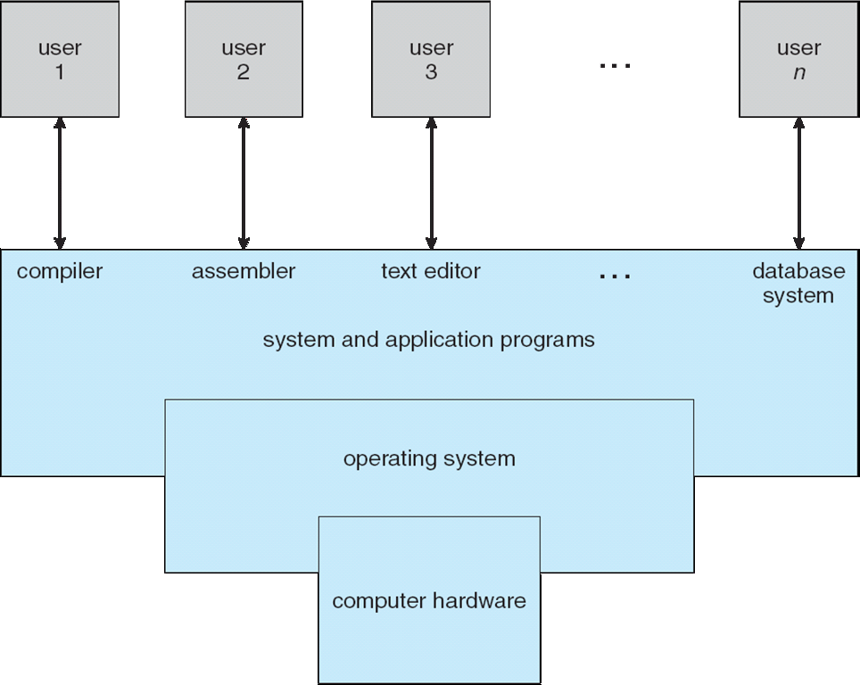
Four Components of a Computer System

Slide 8
Functions of Operating System
Main functions of Operating system A separate module of operating system software performs each of the function: (1). Process management:- Process management module takes care of creation and deletion of processes, and providing mechanisms for synchronization and communication among processes. (2). Memory management:- Memory management module takes care of allocation and de-allocation of memory space to programs in need of this resources.
(3). File management:- It takes care of file-related activities such as organization storage, retrieval, naming, sharing, and protection of files.

Slide 9
Functions of Operating System
(4). Security:- Security module protects the resources and information of a computer system against destruction and unauthorized access.
(5). Command interpretation:- Command interpretation module takes care of interpreting user commands, and directing system resources to process the commands.

Slide 10
Classification of Operating System
Operating System can also be classified as:- (1). Single User Systems:-They are popularly associated with Desktop operating system which run on standalone systems where no user accounts are required. Example: DOS. (2). Multi User Systems:-Provides regulated access for a number of users by maintaining a database of known users. Refers to computer systems that support two or more simultaneous users. Example: Unix, Microsoft Windows NT.

Slide 11
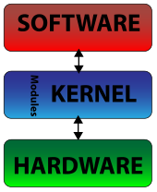
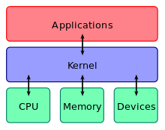
Computer Startup
bootstrap program is loaded at power-up or reboot
Typically stored in ROM or EPROM, generally known as firmware
Initializes all aspects of system
Loads operating system kernel and starts execution
A kernel connects the application software to the hardware of a computer.

Slide 12
Kernel
“The one program running at all times on the computer” is the kernel.
The kernel is a computer program which is the central module of an operating system (OS). It loads first (after the bootloader), and it remains in main memory.
It handles the rest of start-up as well as input/output requests from software, translating them into data-processing instructions for the central processing unit.
It handles memory and peripherals like keyboards, monitors, printers, and speakers.
There are two types of kernels:
A microkernel, which only contains basic functionality;
A monolithic kernel, which contains many device drivers.
A computer user never interacts directly with the kernel. It runs behind the scenes and cannot be seen.

Slide 13
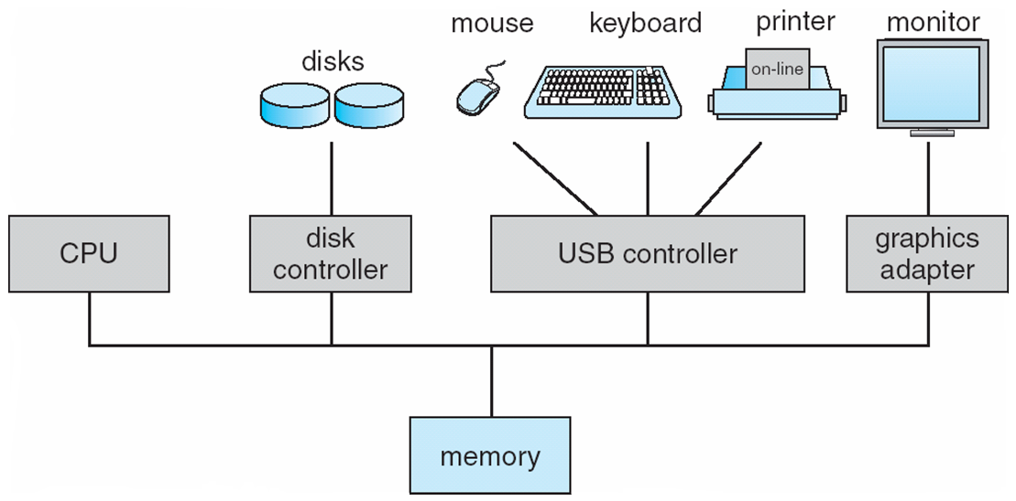
Computer System Organization
Computer-system Organization
One or more CPUs, device controllers connect through common bus providing access to shared memory
Concurrent execution of CPUs and devices competing for memory cycles.

Slide 14
Computer-System Operation
I/O devices and the CPU can execute concurrently
Each device controller is in charge of a particular device type
Each device controller has a local buffer
CPU moves data from/to main memory to/from local buffers
I/O is from the device to local buffer of controller
Device controller informs CPU that it has finished its operation by causing an interrupt.

Slide 15
Storage Structure
Main memory – only storage media that the CPU can access directly
Random access
Typically volatile
Secondary storage – extension of main memory that provides large nonvolatile storage capacity
Hard disks – rigid metal or glass platters covered with magnetic recording material
Disk surface is logically divided into tracks, which are subdivided into sectors
The disk controller determines the logical interaction between the device and the computer
Solid-state disks – faster than hard disks, nonvolatile
Various technologies
Becoming more popular

Slide 16
Storage Hierarchy
Storage systems organized in hierarchy
Speed
Cost
Volatility
Caching – copying information into faster storage system; main memory can be viewed as a cache for secondary storage
Device Driver for each device controller to manage I/O
Provides uniform interface between controller and kernel

Slide 17
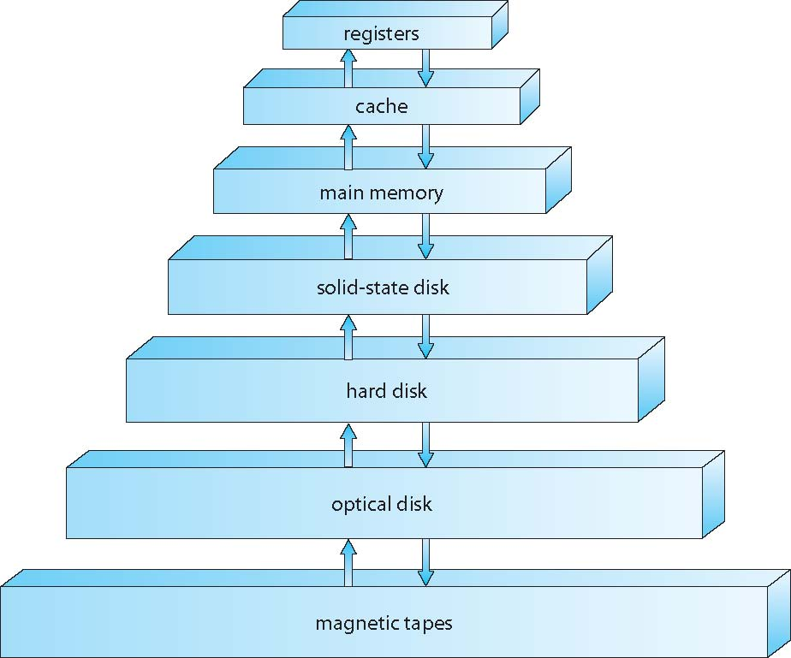
Storage-Device Hierarchy

Slide 18
Caching
Important principle, performed at many levels in a computer (in hardware, operating system, software)
Information in use copied from slower to faster storage temporarily
Faster storage (cache) checked first to determine if information is there
If it is, information used directly from the cache (fast)
If not, data copied to cache and used there
Cache smaller than storage being cached
Cache management important design problem
Cache size and replacement policy

Slide 19
Direct Memory Access Structure
Used for high-speed I/O devices able to transmit information at close to memory speeds
Device controller transfers blocks of data from buffer storage directly to main memory without CPU intervention
Only one interrupt is generated per block, rather than the one interrupt per byte

Slide 20
Operating System Structure
Multiprogramming (Batch system) needed for efficiency
Single user cannot keep CPU and I/O devices busy at all times
Multiprogramming organizes jobs (code and data) so CPU always has one to execute
A subset of total jobs in system is kept in memory
One job selected and run via job scheduling
When it has to wait (for I/O for example), OS switches to another job
Timesharing (multitasking) is logical extension in which CPU switches jobs so frequently that users can interact with each job while it is running, creating interactive computing
Response time should be < 1 second
Each user has at least one program executing in memory process
If several jobs ready to run at the same time  CPU scheduling
If processes don’t fit in memory, swapping moves them in and out to run
Virtual memory allows execution of processes not completely in memory

Slide 21
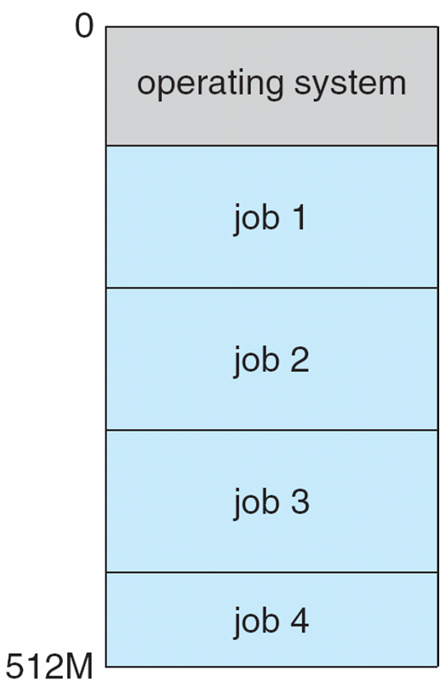
Memory Layout for Multiprogrammed System

Slide 22
Open-Source Operating Systems
Operating systems made available in source-code format rather than just binary closed-source
Counter to the copy protection and Digital Rights Management (DRM) movement
Started by Free Software Foundation (FSF), which has “copyleft” GNU Public License (GPL)
Examples include GNU/Linux and BSD UNIX (including core of Mac OS X), and many more
Can use VMM like VMware Player (Free on Windows), Virtualbox (open source and free on many platforms - http://www.virtualbox.com)
Use to run guest operating systems for exploration

Slide 23
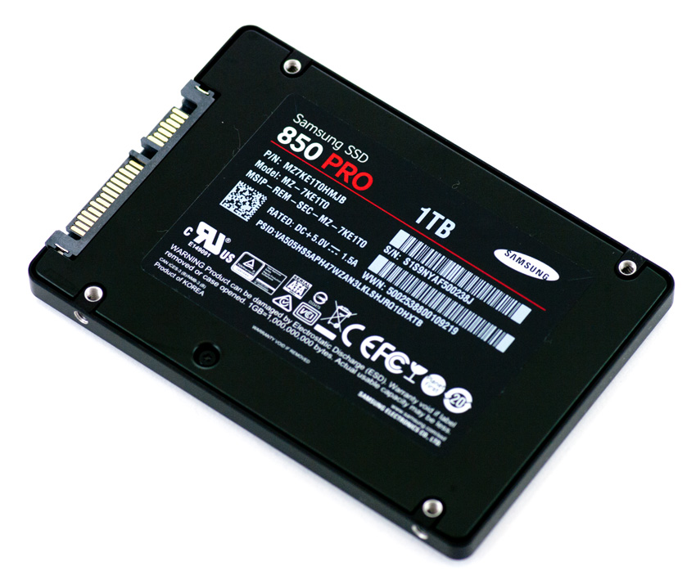
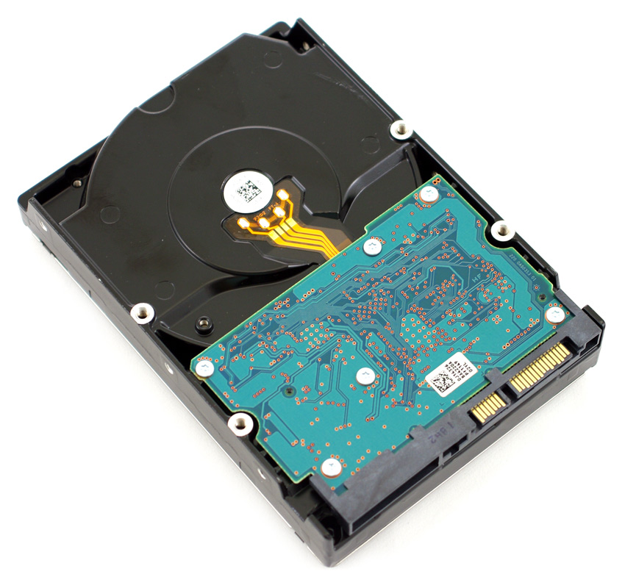
Memory

Slide 24
Questions?
What is an Operating System?
What are the goals of an operating system?
Why OS is required in computer system?
Describe Computer System Components.
What are the functions of Operating System?
Classify of Operating System based on user.
Define Kernel with types.
Describe computer system organization and operation.
Write short note on timesharing and multiprogramming

Slide 25
End of Chapter 1

